Slide 1
A Brief History: Workshop on the Statistical Analysis of Multi-outcome Data (SAM)

Slide 2
History
Originated in 2010, discussing with John O’Quigley
Focus areas: joint model of multiple outcomes, recurrent events, multivariate longitudinal data
Held in even years
Great talks, great place, great meeting

Slide 3
First Workshop (SAM 2012)
1. Curie Institute (Institut Curie) in Paris, France
2. Two day workshop July 9-10, 2012
3. Twenty four invited speakers (8 sessions)
4. Around 100 participants

Slide 4
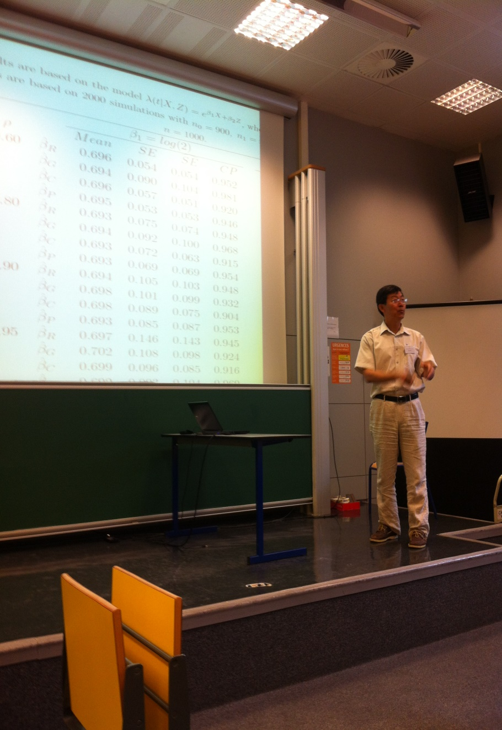


Slide 5
Second Workshop (SAM 2014)
1. In the University of Cambridge, UK
2. Two day workshop June 30-July 1, 2014
3. Twenty four invited speakers (8 sessions)

Slide 6


Slide 7
Third Workshop (SAM 2016)
Renmin (People’s) University of China, Beijing
Two day workshop July 4-5, 2016
Add sessions on e.g., high dimensional multi-outcome data

Slide 8
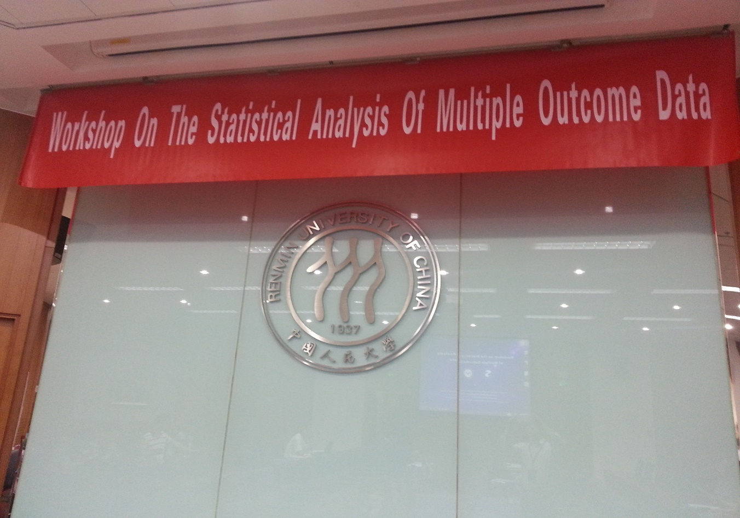
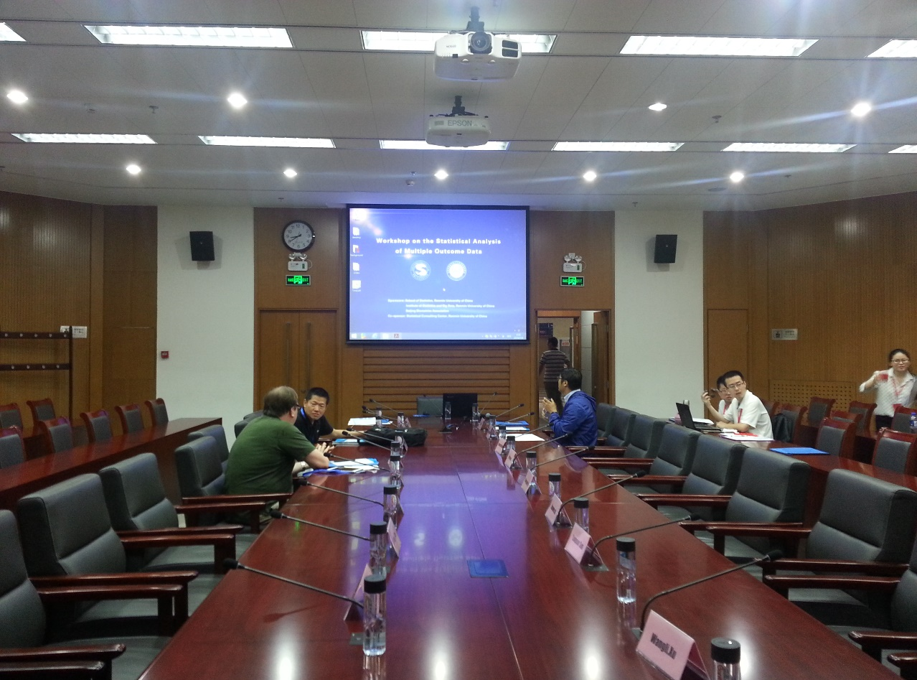

Slide 9
Fourth Workshop (SAM 2018)
Washington University in St. Louis
Two day workshop June 10-11, 2018
Add a poster session for graduate students and poster award for students.

Slide 10
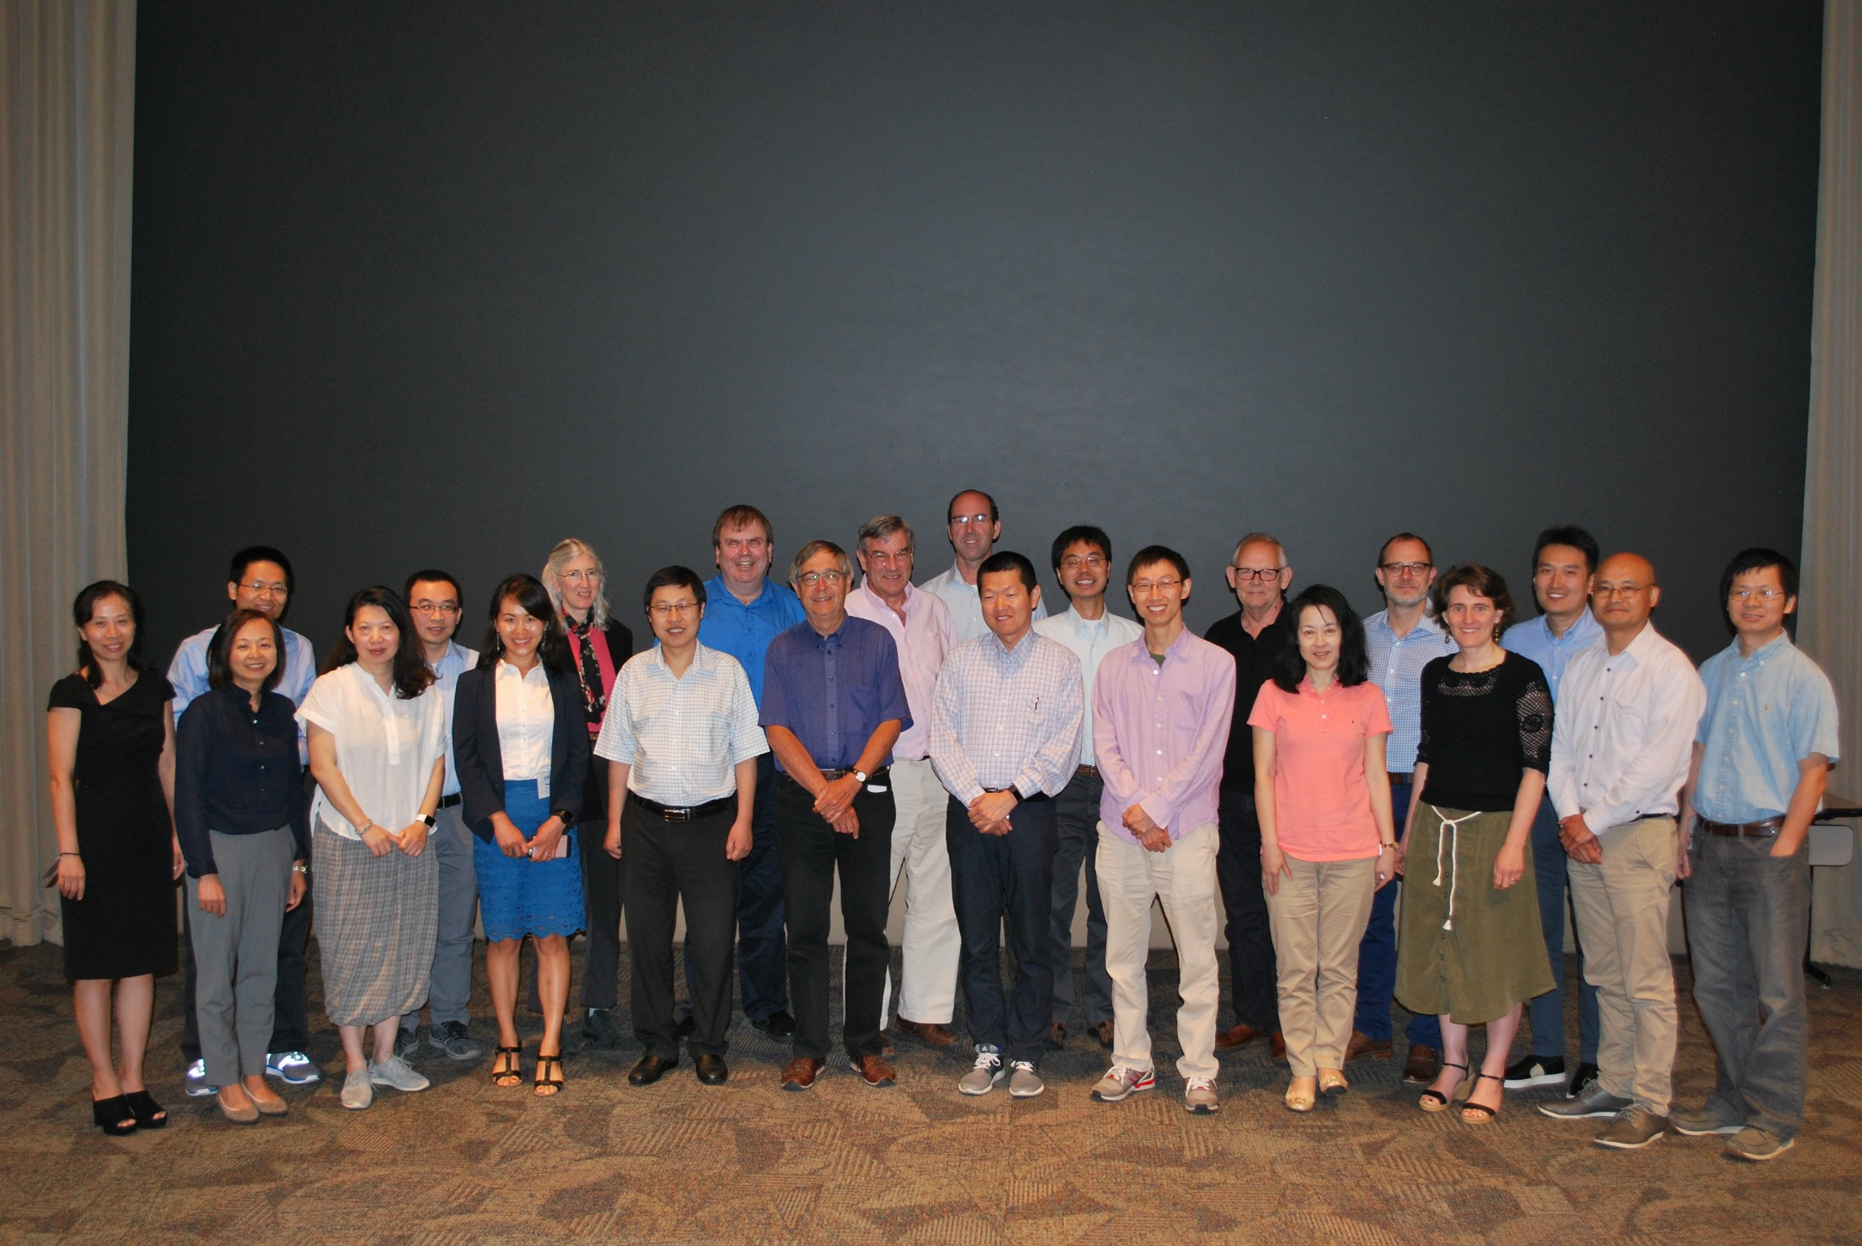

Slide 11
Fifth Workshop (SAM 2024)
1. Originally planned in Emei, Sichuan, China in July 2020
2. Cancelled due to COVID-19
3. Cancelled again in 2022 due to COVID-19
4. Finally comes to the beautiful city of Salzburg!
5. Held in University of Salzburg in July 2024!

Slide 12
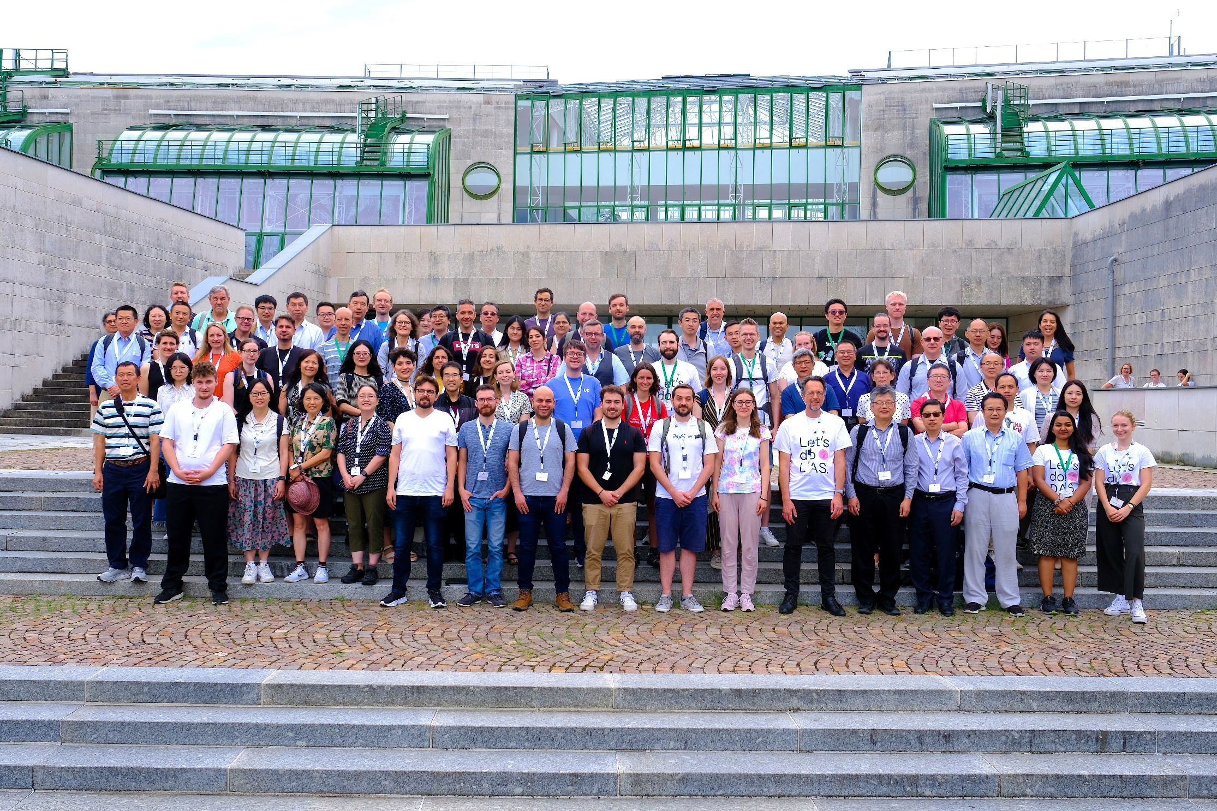

Slide 13

Sixth Workshop (SAM 2026)

Slide 14
Acknowledgements
University of Bordeaux for providing the venue
Ruiwen Zhou for designing the marvelous website!

